Slide 1
QA Invoice and Expenses Project
Mahdy Rahman

Slide 2
Introduction
ForceTraining Ltd are a Salesforce training partner that provides public training.
The task was to create an Invoice and Expense Application in salesforce using administrative, declarative and programming app building tools learnt.
The project was split into 2 phases. Phase 1 was to create an operational with declarative tools. Phase 2 was to implement advanced automation using Apex triggers and classes and visual force pages.

Slide 3
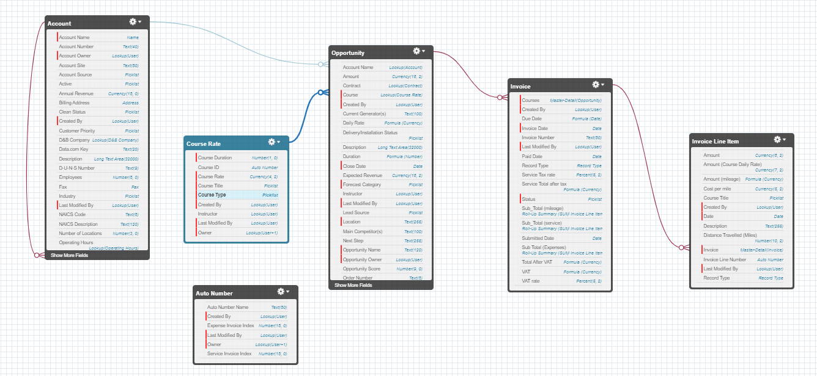

Slide 4
Phase 1

Slide 5


Phase 1: Security
Training Coordinators should have full access to all course records
Instructors should be able to see only course records for them, but not edit the course, except the stage field.
Instructors should have access to their own invoices and no one else.
Billing administrator should have access to all records.

Slide 6
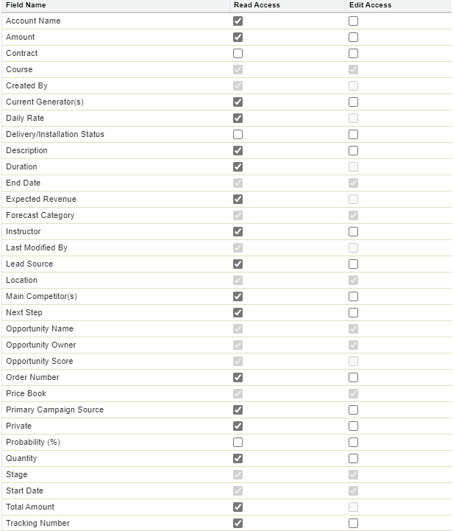
Phase 1: Security
Organize Wide Defaults were set to private as every object had viewing restrictions (at least one group must not see them.
The profile field level permissions would be then set accordingly
Field Level permission example for the instructor profile: Stage field is ticked for edit but all other available fields in edit access is unticked.

Slide 7
Phase 1: Courses
Course records had to specify course type, start and end date, location and stage.
The Opportunity object was used rather than creating a new course custom object and was renamed.
A Course rate object had to be created and a look up relationship was formed, which would allow the course object to call from it the required information

Slide 8
Phase 1: Invoice
A custom parent object called Invoice and child custom object called Invoice line items was created.
Record types had to be used depending on whether a service or a expenses invoice was being made

Slide 9
Phase 1: Validation Rules
Instructor should not be able to change status to submitted unless they have provided a submitted date
Instructor should not be able to change the status to paid unless a paid date is provided
Neither submitted nor paid date should be in the future.

Slide 10
Phase 1: Automation
A Process builder was created so that the instructor could be notified if a service or expense invoice has not been paid by the invoice due date

Slide 11

Reporting & Dashboards

Slide 12
Phase 2

Slide 13
Phase 2 Introduction
Used Visual code studio as our IDE and connecting directly to the developer org through Salesforce extensions within visual studio
Created Apex classes and triggers, which allowed the code to run in the org.
Testing had to be done on the classes with an aim to achieve 75% minimum testing coverage.

Slide 14

Retrospective
Majority of criteria was fulfilled although some aspects of functionality were missing.
Testing coverage was not fully completed to the required criteria and going forward this should be an area of focus.

Slide 15
End

